Slide 1
Project 2 - Ames Housing Data and Kaggle Challenge
DSI – 20
Daphne Kwok

Slide 2
Workflow
Data Cleaning
EDA
Holdout set
Modeling
Test Set
Import train.csv and clean data (replacing Null values..etc)
Import test.csv and clean data
Sort into
Continuous,
Categorical,
Ordinal Columns
2. Plot correlation
matrix, scatterplots,
Boxplots, Violin plots
3. Infer Features for predicting ‘Sale Price
Train_test_split train dataset into Train & Holdoutset
Preprocessing on X_train & X_holdout set
Preprocess using StandardScaler & pd.get_dummies
Compare RMSE from Linear Regression,
Lasso Regression,
Ridge Regression on holdout set
2. Choose model with lowest RMSE to predict test set
Preprocess on entire train set and test set
Predict ‘SalePrice’ using chosen Regression model
.

Slide 3
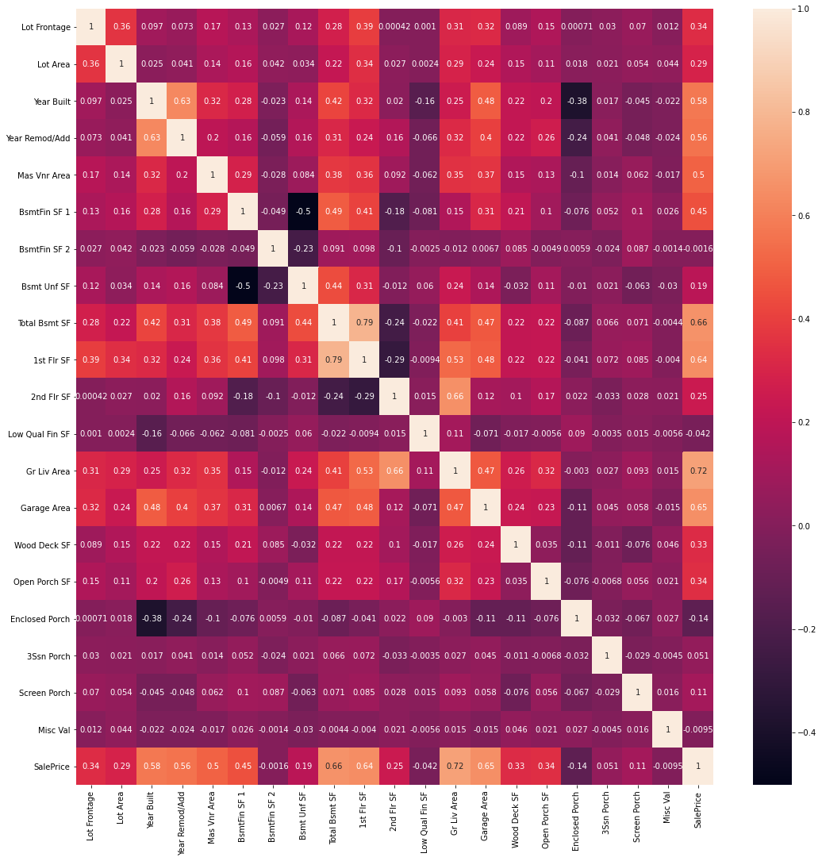
EDA – Continuous Categories – Correlation Matrix
'Gr Liv Area' shows the strongest positive correlation based on the lightest color plot.
2. 'Enclosed Porch’ show negative correlation against 'SalePrice' based on the darkest plot
3. The variables showing the lighter colors in relation to 'SalePrice' might be good for predicting 'SalePrice'

Slide 4
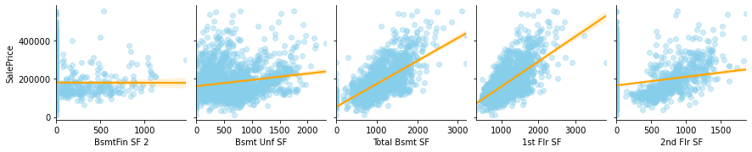
EDA – Continuous Categories - PairPlot
Inference from sns.pairplot with regression line
if the gradient of the regression line is positive, it seems to signal a positive correlation with 'SalePrice’
if the gradient of the regression line looks near zero, the variable will not be helpful in predicting 'SalePrice'
noticed that many scatterpoints are value zero, will need to visualize the distribution of the variable

Slide 5
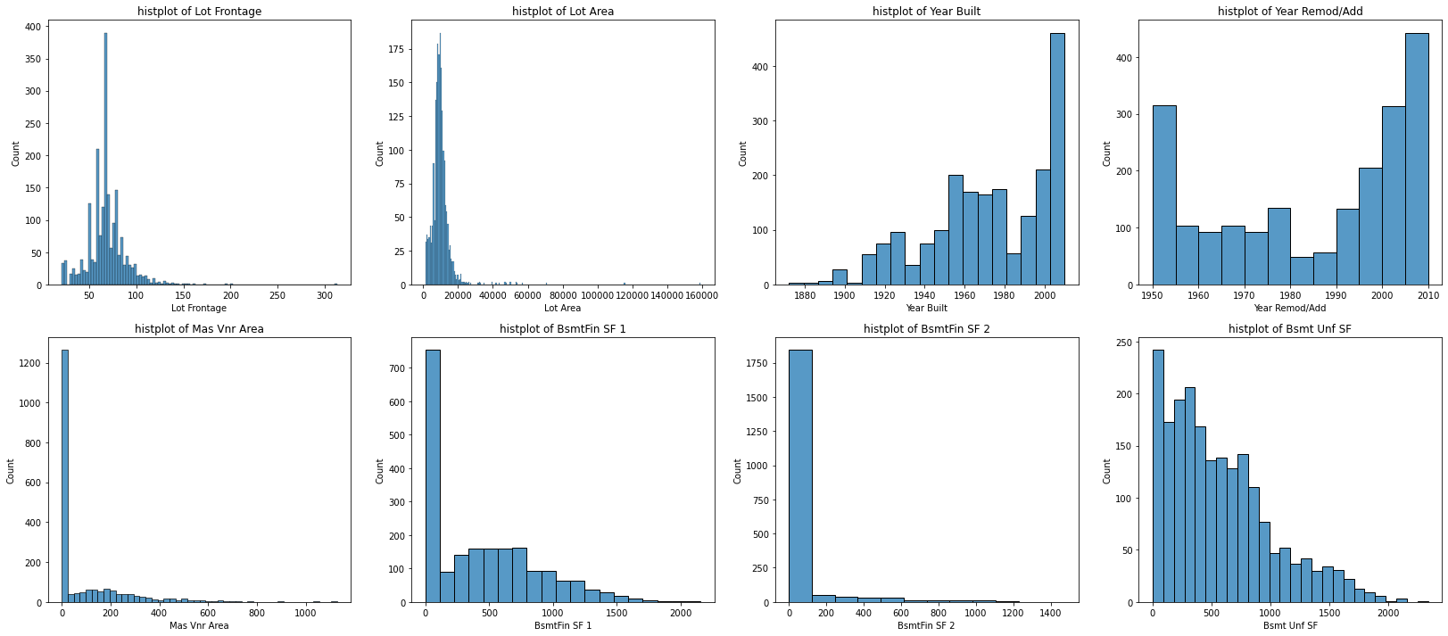
EDA – Continuous Categories - DistPlot
Inference from sns.pairplot with regression line
Variables like 'Screen Porch','Misc Val' has high frequency of 0 in their columns
may not be useful for prediction 'SalePrice' as compared to other variables. This is confirmed by checking what is the mode of each column

Slide 6
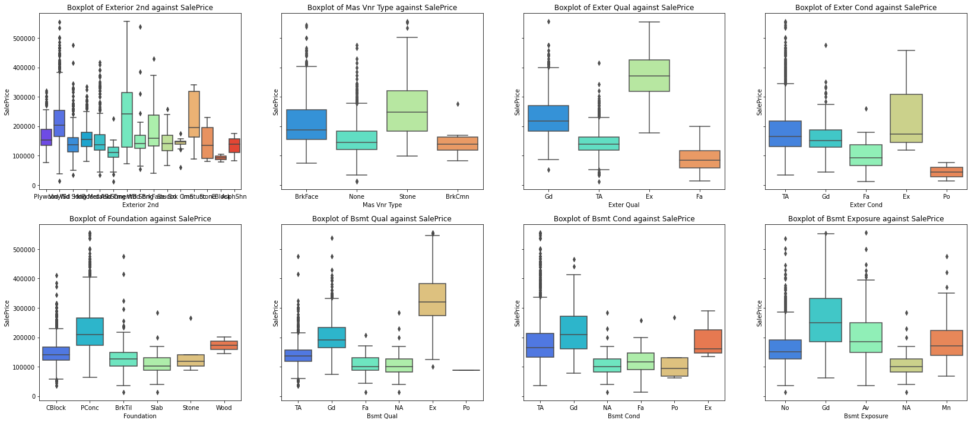
EDA – Categorical (Nominal & Ordinal) - Boxplot
Inference from boxplot of categorical & ordinal variables
There are a ordinal & categorical variables that are have boxplots in the same range, meaning that different category/ordinal will not be useful in predicting 'SalePrice'
Ordinal columns like 'Overall Qual' has distinct boxplots and can be useful for predicting 'SalePrice

Slide 7
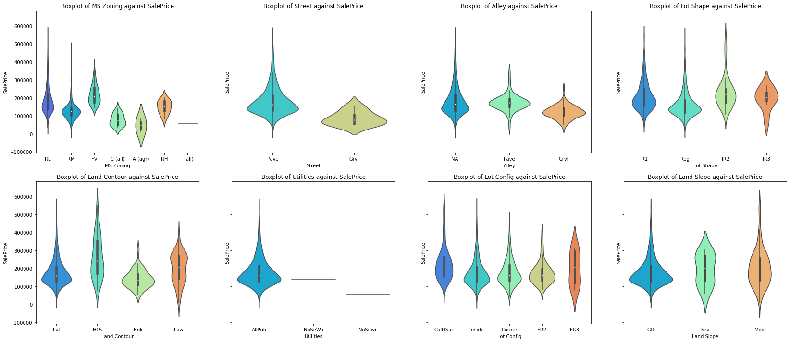
EDA – Categorical (Nominal & Ordinal) - Violinplot
Inference from violinplot of categorical & ordinal variables
Violin plots help to show distribution of each category in the boxplot
There are a few violin plots like 'Pool Area' where most of the houses were sold in 1 category, this will not be helpful in predicting 'SalePrice'

Slide 8
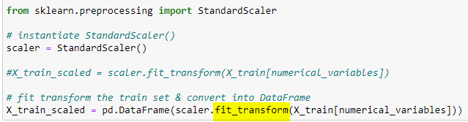

EDA – Preprocessing
Choose the features in train dataset
Train_test_split into train & holdout set
3. For the train & holdout set: StandardScale the numerical columns & Get_dummies for categorical columns
4. After preprocessing is complete. Use the train and holdout set on the models to compare RMSE
5. After choosing model with lowest RMSE score, preprocess the entire train and test dataset and use model for submission

Slide 9
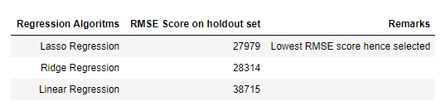
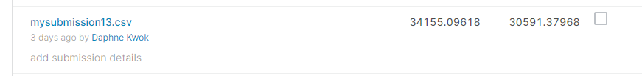
CONTENTS OF THIS TEMPLATE
CONTENTS OF THIS TEMPLATE
Model Comparisons on holdout set:
RMSE from Kaggle submission:

Slide 10
CONTENTS OF THIS TEMPLATE
CONE
Conclusions:
EDA helps to eliminate obvious variables that do not help in predicting 'SalePrice' by visual inference
Lasso & Ridge Regression introduce regularization and helps avoid overfitting like the Linear Regression.
Lasso Regression produced a better RMSE score that Ridge Regression as Lasso will shrink the unimportant features to 0, this minimizes RMSE.

Slide 11
CONTENTS OF THIS TEMPLATE
Recommendations:
Interested buyers may use this model to predict the estimate 'SalePrice' for houses in Ames.
Sellers may use this model to predict how much they can offer their houses for sale.
In addition, Real estate agents can estimate which features contribute to 'SalePrice' and may provide advise to buyers/sellers why that house is priced at that estimated value.

